Slide 1
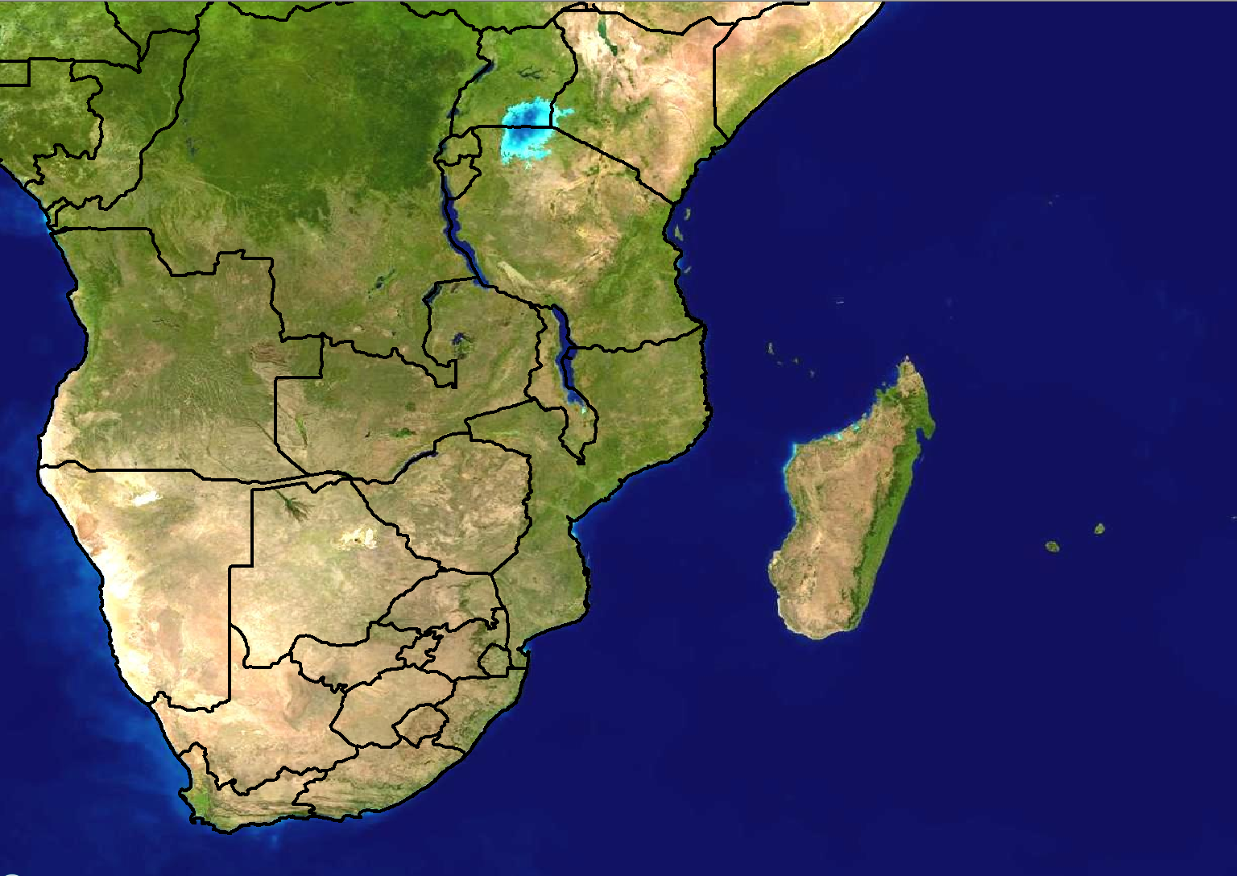
Scenario 1: Forecast for Day 3
24 hour rainfall (mm)
>100
80-100
60-80
40-60
20-40
Forecast issued:
Monday 20 February
Forecast valid:
Wednesday 23 February

Slide 2
Scenario 1 - Additional information:
There is a tropical low pressure that is expected to develop over the north-eastern parts of Namibia on Wednesday.
The exact position is not very certain at all at the moment as most models are not in agreement.
Currently there is just an easterly wave over the northern parts of Botswana and Namibia which is expected to develop into a low pressure on Thursday
Models are relatively in agreement with the amount of rainfall expected, with the bulk of it being over the northern parts of Namibia
A live concert is scheduled to take place at the Windhoek Stadium on Wednesday evening

Slide 3
Scenario 2: Forecast for Day 1 (Today)
24 hour rainfall (mm)
>100
80-100
60-80
40-60
20-40
Forecast issued:
Wednesday 23 February Forecast valid:
Wednesday 23 February

Slide 4
Scenario 2 - Additional information:
Tropical low pressure is currently positioned where the models expected: over the north parts of Namibia.
Models are in agreement with the placing of rainfall amounts of 40-60mm in 24 hours.
The Unified Model (12km) shows 6 hourly rainfall amounts of >100mm over a much larger area than GFS, therefore some discontinuity exists there.
A live concert is still scheduled to take place at the Windhoek Stadium this evening

Slide 5
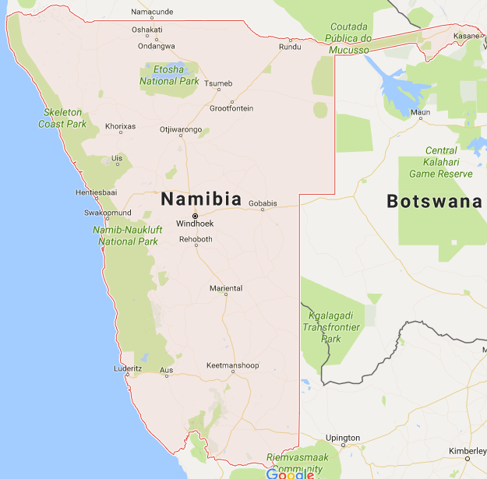
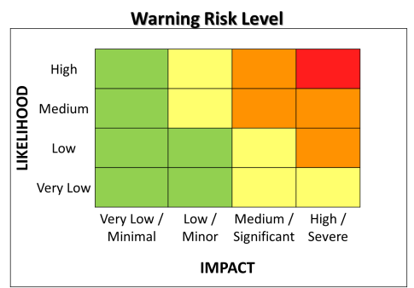

Slide 6
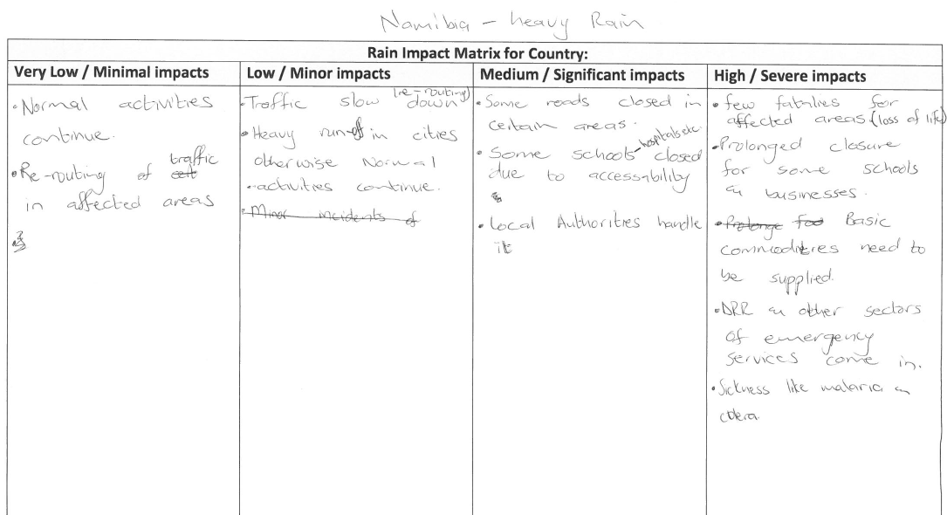

Slide 7
